Slide 1
ER Diagram & Project Scheduling
of
Edu-Right
180041203
Md. Sajid Altaf
180041204
Syed Mohammed Sartaj Ekram
180041219
Adham Arik Rahman

Slide 2
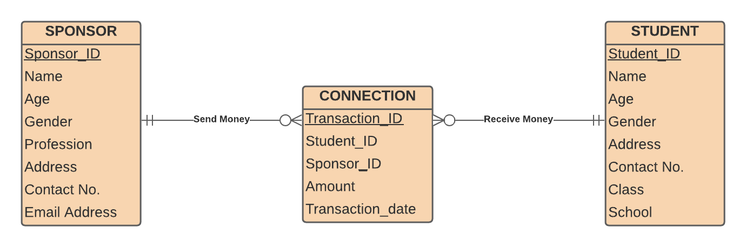
ER Diagram

Slide 3
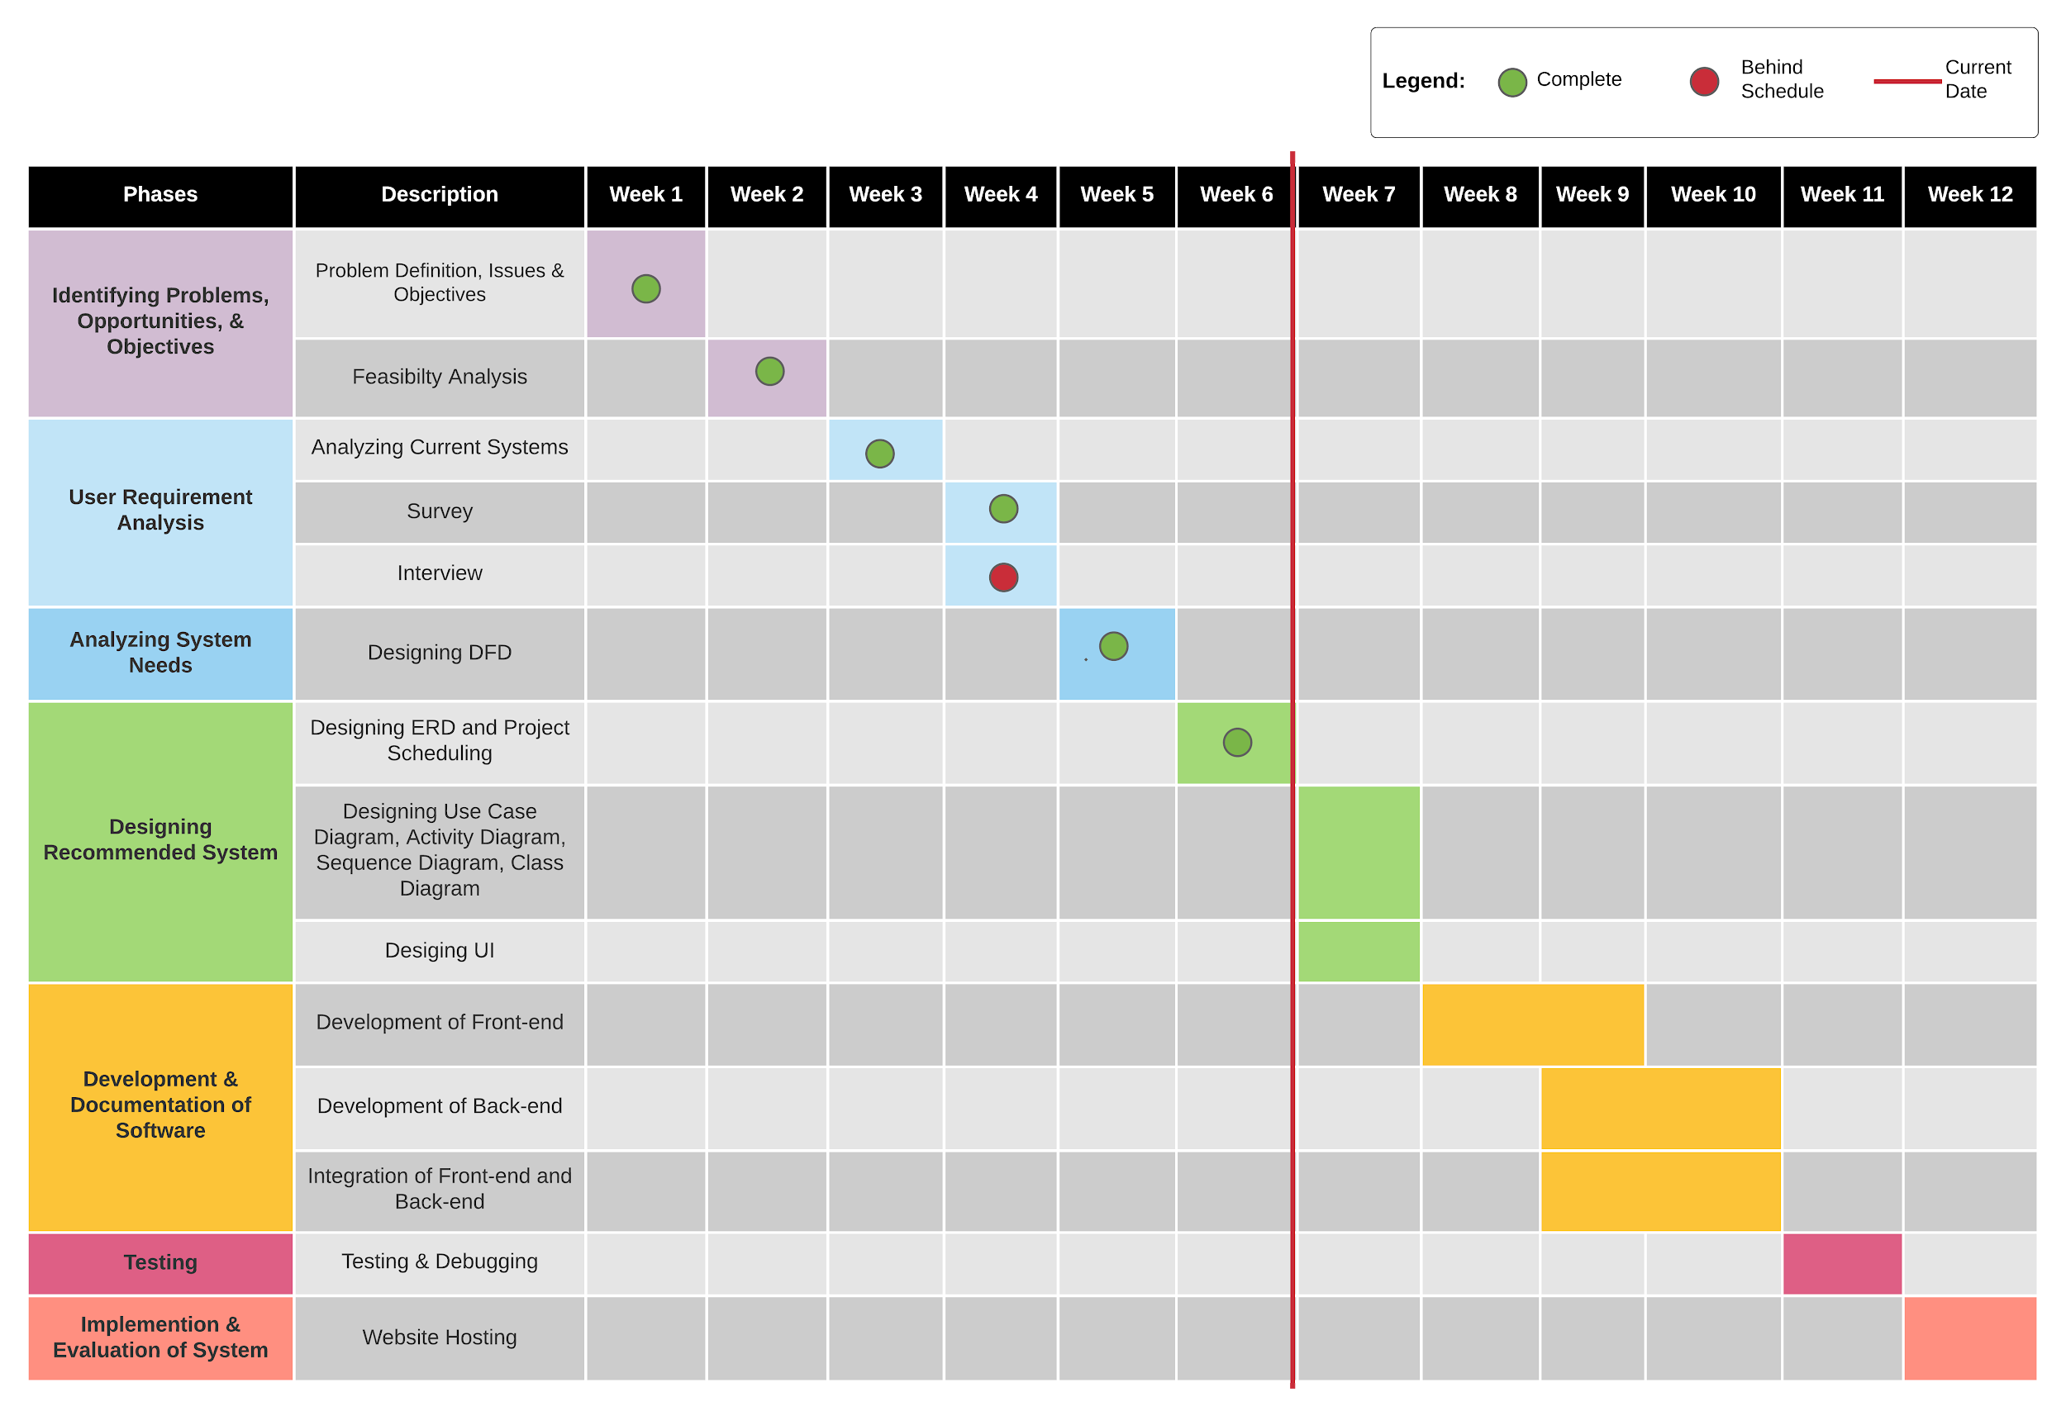
Gantt Chart

Slide 4
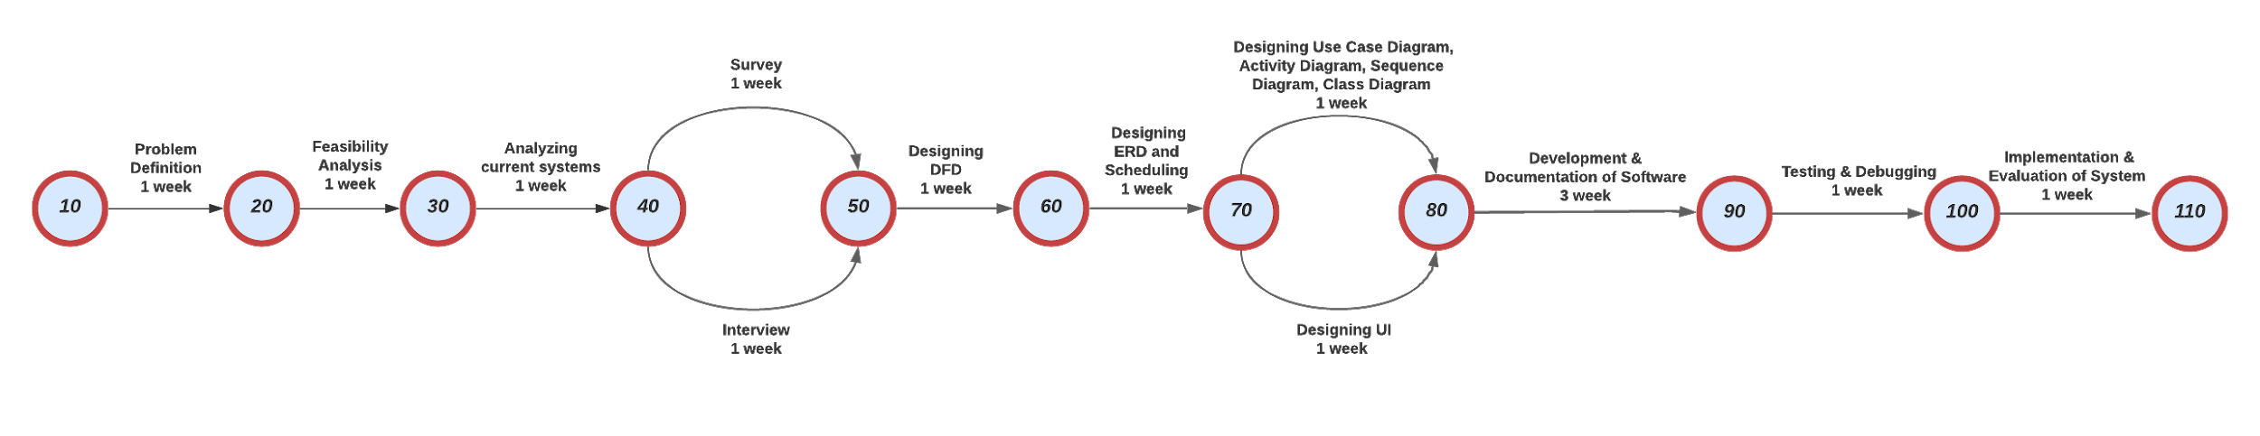
PERT Chart

Slide 5
Thank You

